Slide 1
Welcome

Slide 2

Post Graduation Diploma Project
PG-DAC
E-Salon Booking System
Submitted By
Rupesh Gholap (230343020032)
Anmol Patil (230343020066)
Bhairavsing Patil (230343020068)
AshwinKumar Ubare (230343020105)
Guided By
Mrs: Dipali Jadhav
2

Slide 3
Contents
Introduction​
Architecture
​Database Design
Technology platform used for project
User roles and responsibilities
Division of work within team
Details of contribution of each team members
File and directory structure for project
Read me file
Future extension if any
Conclusion
3

Slide 4
Introduction
In today's fast-paced world, finding the time to schedule salon appointments can be a challenge. That's why we've created a user-friendly web application that allows you to effortlessly book your salon services from the comfort of your own home or on the go.
we can view real-time availability of salon, choose the date and time that works best for you, and even select your preferred stylist—all with just a few clicks.
4
Notes:
Hive and Hive QL statements have been used for querying the data.
For future scope, various different Machine Learning algo0rithm will be implemented on different flight delay datasets.

Slide 5
Project Architecture
Used for
User interfacing
Basic data validation
Used for
Server side validation
Response handling
Business Logic
Database operations
Used for
Permanent data storage
Database level validation
Database access using stored procedures
Frontend Layer
Server Layer
Technologies used
HTML, CSS
Javascript, jQuery
ReactJS
JSON
Technologies used
Springboot
Hibernate
Database Layer
Technologies used
MySQL

Slide 6
Technology Platform Used
Technologies Used :
HTML, CSS, Javascript, jQuery, ReactJS, JSON, Springboot, Hibernate, MySQL
Reason :
HTML, CSS and Javascript are used for frontend part for static web pages.
React JS is used for rendering the dynamic web pages and to create a single page application where only particular part of web page is rendered without altering complete web page.
Springboot is used for server side processing wherein in connection with database is established from server and required data is manipulated and sent to client side.

Slide 7
Roles and responsibitities
Roles:
Admin
Salon Owner
Customer
Responsibilities of each Role:
Admin: Account management, permission to allow salon profile, report generation.
Salon Owner: Create profile, add barber, add services, get appointment, provide services.
Customer: Create profile, select city, select salon, select barber, select services, generate bill, book appointment.
User cases of each user:
7

Slide 8
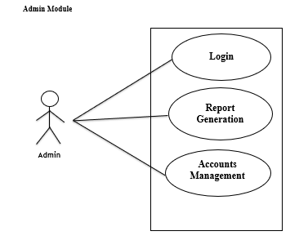
Admin

Slide 9
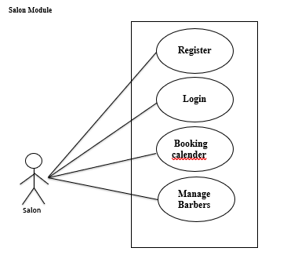
Salon

Slide 10
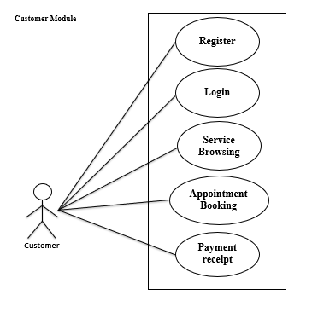
Customer

Slide 11
Division of work within team
Rupesh Gholap : Work on Frontend, Backend
Anmol Patil : Work on Middleware, Frontend, Backend
Bhairavsing Patil : Work on Middleware, Backend
AshwinKumar Ubare : Work on Frontend, Backend
Stages at which Coordination was needed:
Most of the coordination was needed when complete UI needed to be rendered using React,
Every one worked together for designing the Database(Backend)
11

Slide 12
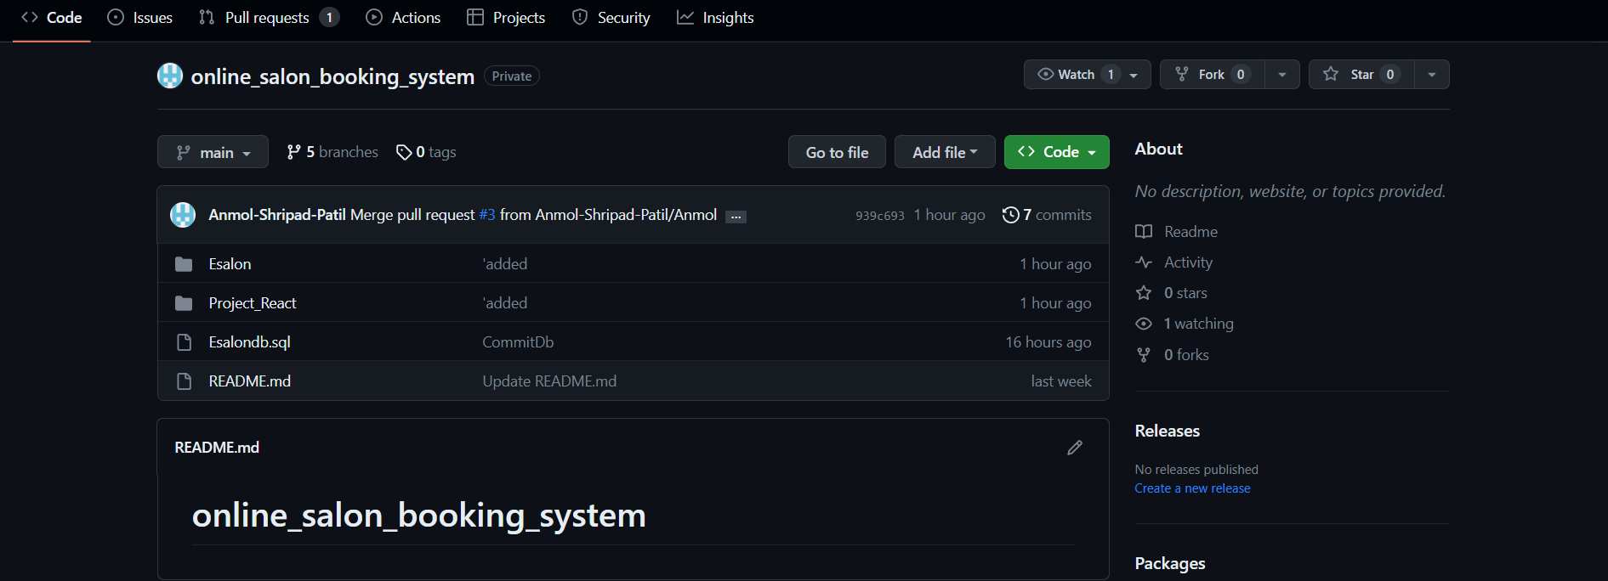
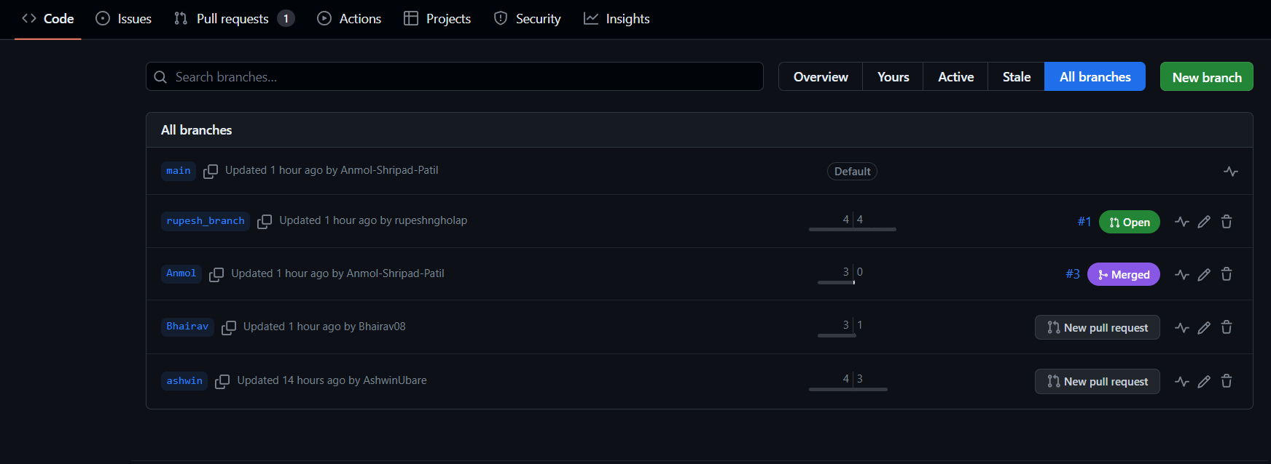
GitHub
GitHub link: https://github.com/Anmol-Shripad-Patil/online_salon_booking_system.git
Photo shoes branches and commits

Slide 13
Features
Admin can allow Salon Owner.
Admin can can delete Salon Owner account.
Admin can manage account details.
New user can create profile and edit profile.
User can select city, select salon, select barber.
User can book appointment, select services, remove service, conform appointment cancel appointment.
Salon owner can add details and register his shop.
Salon owner can add services, add barber, get appointment, cancel appointment.
User can add review to salon shop.
13

Slide 14
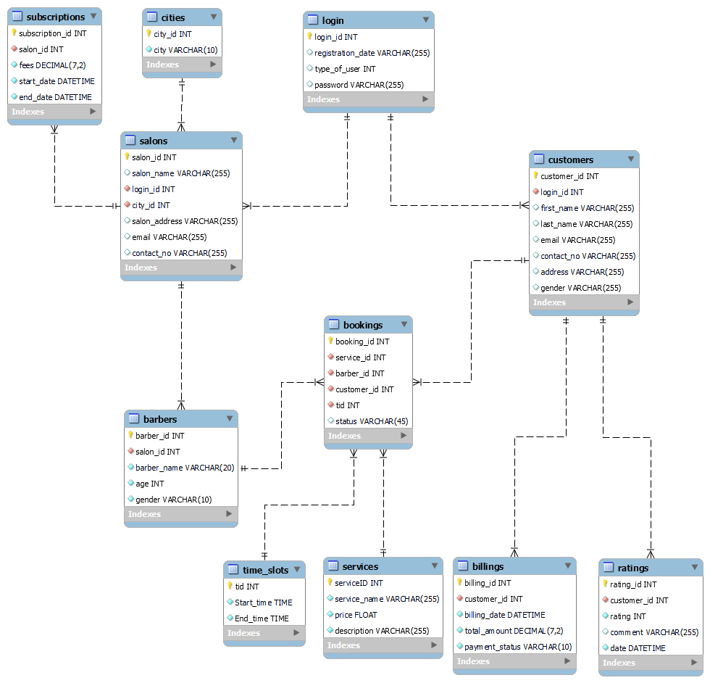
Database ER Diagram

Slide 15
Benefits
No need to waste time in waiting in salon shop.
It is very easy to use.
Book appointment as per your time and date.
User can select favorite salon shop and barber/stylists which is available in E-Salon.
It saves a lot of time.
Book appointment in advance.
Salon owner can Increased Revenue by getting online customer.
For Booking no need to visit shop or making phone calls on open E-salon web and see available slot, services and book it.
15

Slide 16
Benefits
For user no need to pay in advance for booking.
Due to E-Salon booking system Salon owner can making indirectly there shop advertisement.
16

Slide 17
Future Scope
Global Expansion: The system could expand its services to cover a broader geographic area, possibly even offering multi-language support for international customers.
Subscription Models: Introducing subscription-based models for regular customers, offering benefits like priority booking, discounted services, or loyalty rewards.
Mobile Experience Enhancement: The system can develop dedicated mobile apps that offer a seamless booking experience, including push notifications for upcoming appointments and exclusive offers.
Integration of Social Media: Integration with social media platforms can allow customers to share their new looks easily and even book appointments directly from platforms like Instagram or Facebook.
17

Slide 18
Conclusion
Customers can now effortlessly browse available services, choose their preferred time slots, and even select their preferred stylists. On the other hand, salons can better manage their resources and offer personalized services.
Through this system, customer satisfaction has increased significantly due to the reduced wait times and the ability to plan their salon visits ahead. Moreover, salon owners have witnessed improved operational efficiency and increased revenue, as they can optimize their staff's schedules and allocate resources more effectively.
18

Slide 19
Thank
You
19

